Slide 1
Boost Your Professionalism Through Better Writing

Slide 2
Whack Wordiness
Word Clutter:
“the leeches that infest the pond of prose, sucking the blood out of words.”
– Strunk & White, The Elements of Style
Notes:
Whack wordiness is a term I’ve coined to help us get rid of word clutter that muddies our writing. What is word clutter? I love this definition from the classic writing book first published in the 30s.

Slide 3
Whack Extraneous Phrases
It’s all about, the fact of the matter is
Is intended to, is designed to, is meant to
There is, there will be
Is going to
In regard to

Slide 4
My All-time Favorite
The reason why is that
Hint: A simple “because” will suffice

Slide 5
Whack Wobbly Words

Slide 6
Common Wobbly Words
Really (overused, lazy)
Some (vague, be specific)
Much (doesn’t add anything)
Very (overused, be descriptive)
That (can delete often)
Notes:
Take out wobbly words like some, much, very, quite a few, that whenever you can. Why does that matter? Because they’re imprecise and just don’t add anything most of the time. In fact, they can diminish the impact of what you want to say.
And let’s face it. You don’t need them to get the meaning across:

Slide 7
Use “Who” not “That” for a Person

Slide 8
Whack Wordiness by One-Third
Dig out something you wrote and select the longest paragraph.
Count the words in that paragraph and rewrite it, reducing the number by one-third. e.g., 99 words becomes 66 words
Notes:
If you like the result, keep doing it.

Slide 9
Your Ultimate Goal
Don’t make your readers work hard (because they won’t)!

Slide 10
Notes:
Let’s say you go into your office tomorrow morning and right off the bat, you have to write that email to get an important project moving. You stare at your computer screen like an artist stares at a blank canvas.
Here’s what I want for you. I want you to cut the amount of time you spend writing that piece by going through a simple planning process. Not only will it help you say what you intend to convey but it will help you get over that start-up fear that occurs when you’re just not sure. I use this technique a lot when writing articles and blog posts and especially those sensitive emails and proposals.
I call this planning process Setting Your Objectives.

Slide 11
Set Your Objectives
Who: ___________________ (recipient)
What: ___________ (message, takeaway)
Why: _____________ (benefits to reader)
When/Where: ______________ (logistics)
How: ____________ (tone, style, attitude)

Slide 12
Set Your Objectives
Example:
Who: decision-maker in credit card company
What: request to refund $$
Why: company doesn’t want to lose a customer and mar its reputation

Slide 13
Set Your Objectives
Example:
When: the next payment cycle (state month)
How: tone is businesslike, serious, cooperative but stern, demanding

Slide 14
Write down one project in which you think this technique would be useful.

Slide 15
Pursue a Parallel Path
Avoid taking two or more different paths in your writing.

Slide 16
Pursue a Parallel Path
Example:
His attitude makes a difference in changing, succeeding, and when he wants to move on.

Slide 17
Pursue a Parallel Path
Better:
His attitude makes a difference in changing, succeeding, and moving on.

Slide 18
Pursue a Parallel Path
Example:
We created a new presentation, client delivery is the next step planned, and we need feedback so we’ll do some brainstorming.

Slide 19
Pursue a Parallel Path
Example:
We created a new presentation, planned to deliver it, and brainstormed ways to receive feedback.

Slide 20
Pursue a Parallel Path
Non-parallel bullet points:
Single space between sentences
Change any straight quotes to curly quotes
Ending period goes inside quotation mark
Subheads if appropriate
Bullet points indented 5 spaces

Slide 21
Pursue a Parallel Path
Parallel bullet points:
Use a single space between sentences
Change any straight quotes to curly quotes
Put ending period inside quotation mark
Add subheads if appropriate
Indent bullet points 5 spaces

Slide 22
Punctuate and Proofread with Fresh Eyes

Slide 23
Punctuation Craziness

Slide 24
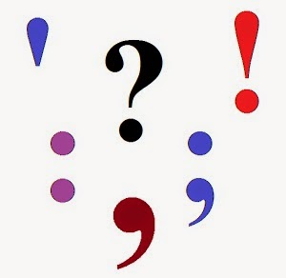
Punctuation Quiz
Punctuate this:
Before its time for lunch; take care of the recently-sent emails.

Slide 25
Punctuation Quiz
Answer:
Before it’s time for lunch, take care of the recently sent emails.

Slide 26
Punctuation Quiz
Punctuate this:
The buildings interior was remodeled however the façade wasnt changed.

Slide 27
Punctuation Quiz
Answer:
The building’s interior was remodeled; however, the façade wasn’t changed.

Slide 28
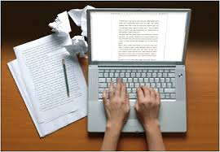
Proofread with Fresh Eyes
Reread what you wrote at least t_____ times.
Notes:
You might say a lot of problems with written communication can be cured by proofreading. But what does proofreading really mean? What can you do to proofread better? Help to fill in the blanks.

Slide 29
Proofread with Fresh Eyes
Reread what you wrote three times.
Ten or twenty is great, too.
Notes:
You might say a lot of problems with written communication can be cured by proofreading. But what does proofreading really mean? What can you do to proofread better? Help to fill in the blanks.

Slide 30
Proofread with Fresh Eyes
Have at least t____ other people read it.
Notes:
You might say a lot of problems with written communication can be cured by proofreading. But what does proofreading really mean? What can you do to proofread better? Help to fill in the blanks.

Slide 31
Proofread with Fresh Eyes
Have at least two other people read it.
Or three or more.
Notes:
You might say a lot of problems with written communication can be cured by proofreading. But what does proofreading really mean? What can you do to proofread better? Help to fill in the blanks.

Slide 32
Proofread with Fresh Eyes
Reread ONLY after you have let it sit for t_____ to t_______ minutes.
Notes:
You might say a lot of problems with written communication can be cured by proofreading. But what does proofreading really mean? What can you do to proofread better? Help to fill in the blanks.

Slide 33
Proofread with Fresh Eyes
Reread ONLY after you have let it sit for ten to twenty minutes.

Slide 34
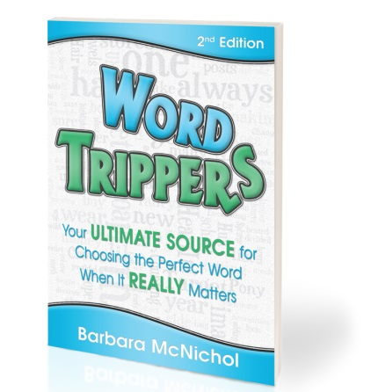
Match the Word to the Meaning
Notes:
Do you write “further” when you mean “farther” or “accept” instead of “except”? In these days of texting and Twitter, why care about getting these words correct? Mostly, you don’t want to embarrass yourself or confuse your reader. Plus it gets in the way of saying exactly what you mean to convey.
In my Wordshop, attendees select a WT from a list of from my book and make up a sentence using both words in one sentence. They get the fun of doing what I do for my ezine called Word Tripper of the Week. We won’t do that today, but I do want to draw your attention to three common WT.

Slide 35
Word Tripper
Advice, advise – “Advice” is a noun; “advise” is a verb. “The advice you receive is only as good as the people who advise you.”
To remember the difference, think of the word “ice,” which is a thing (a noun) and not an action (a verb).
Notes:
Common mistake is… mini-commercial here

Slide 36
Word Tripper
Number, amount – You’ve likely heard people say, “Consider the amount of stores or the amount of muffins, etc.” In these phrases, the word “number” should be used instead of “amount.”
Hint: If you can quantify or count the objects, use “number,” not “amount.” Therefore, the correct phrases are “Consider the number of stores, the number of muffins, etc.”
Notes:
Common mistake is…

Slide 37
Word Tripper
That, which – Use “that” when the phrase that follows is essential to the meaning of the sentence.
“We provide guides that serve as an alternative to our programs.”
Use “which” when the phrase gives information but isn’t critical to understanding the sentence.
“The self-teaching guides, which complement services we offer, provide an alternative to our programs.”
Notes:
Common mistake is… mini-commercial here

Slide 38
NEW! Word Tripper Tips
A subscription program from ODI for $99/year

Slide 39
Word Tripper Tips
Keeps you “in the know”
Builds your confidence
Increases respect and self-assurance
Boosts your reputation for competence
Shines a light on what you didn't know you didn’t know. ☺

Slide 40
Word Tripper Tips
Word Tripper of the Week (+ audio)
One a week for 52 weeks
Word Trippers eBook
390+ Word Trippers
Webinar on techniques for better writing
Quarterly bonuses with writing tools
Crossword puzzles and more!

Slide 41
Word Tripper Tips
Subscribe to Word Trippers Tips at www.WordTrippers.com/odi
Notes:
Good communication is the cornerstone of effective interpersonal relationships both inside and outside of the workplace.
In the workplace, communication is at the heart of effective teams and high performance organizations. In fact, workers send and receive about 1800 messages from day to day via telephone, email, faxes, papers and face to face communication. (Study using Fortune 100 companies.)
Subscribers to the Harvard Business Review rated the ablity to communicate “the most important fact in making an executive promotable.”

